Slide 1
Falls Prevention
Notes:
Thank you for joining us for this Falls Prevention Presentation brought to you by the Howard County Office on Aging and Independence.

Slide 2
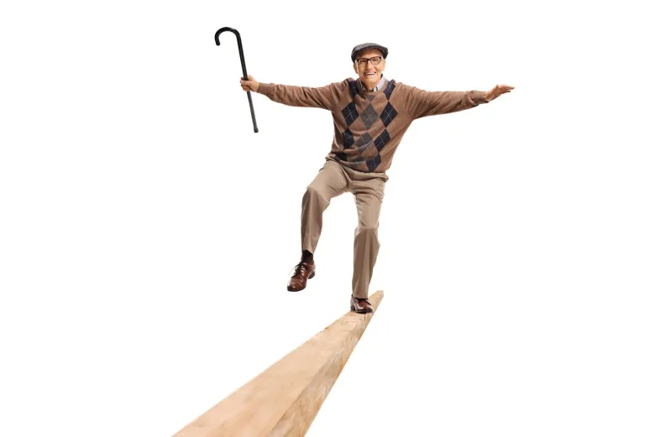
Why Do Falls Occur?
According to National Institute on Aging (NIA), more than one in four people age 65 years or older fall each year. The risk of falling — and fall-related problems — rises with age.
Many things can increase the risk of falls:
Medications
Vision and Hearing Loss
Home Environment
Blood Pressure
Chronic Disease
Risk Taking
Lack of Exercise
Fear of Falling
Notes:
According to the National Institute on Aging (NIA), more than one in four people age 65 years or older fall each year. The risk of falling rises with age.
Anyone can have fall however the risk of falling does rise with age and for an older adult the consequences of a fall can have far more negative and long lasting effects than for a younger person. An older adult may have medical conditions like osteoporosis that increases the risk of a broken bone if a fall occurs.
So there are many contributing factors that can increase your risk of falls.
Like medications, which may have side effects like dizziness or feeling lightheaded.
Vision and hearing loss - you may be experiencing depth perception or peripheral vision loss and/or vertigo
Your Home environment may put you at increased risk – is it cluttered or do you experience decreased mobility and have to climb stairs to get to a full bath and bedroom
Chronic diseases like diabetes, heart disease – which can affect blood pressure and blood sugar
Risk taking - it’s important to recognize your limits and weigh the consequences
Lack of exercise – our muscles atrophy a lot faster as we age as the saying goes “use it or lose it”
Lastly, and something a lot of us don’t think about is a fear of falling. Fear of falling often keeps us from participating in activities which makes us more sedentary which then puts us at increased risk for falls.

Slide 3
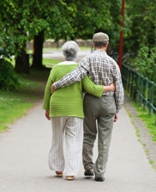
How To Prevent Falls
Speak with your health care provider about your prescription and over-the-counter medications, and their potential side effects that may increase your risk of falling.
Have your hearing and vision checked annually or sooner if you experience changes in either.
Wear properly fitting shoes with non-slip soles.
Be aware of your surroundings. Watch for changes in elevation, pets, slippery surfaces, etc.
Notes:
So let’s talk about how to prevent falls
It’s important to talk to your health care provider and pharmacist about all the medications and over-the-counter supplements you are taking. Medications and supplements can have side effects and can negatively interact with each other. Best practice to review your medications annually with your Primary care doctor and specialists to be sure they are still necessary.
Have your hearing and vision checked annually or sooner if you’re experiencing changes. If you find your misjudging the height of steps/curbs – you could be experiencing depth perception loss – this increases your risk for falls.
As well, hearing loss and vestibular conditions can cause vertigo, loss of balance and an inability to hear your surroundings. And wear your hearing aids.
Wearing properly fitting shoes with non-slips soles is important – women like to wear heels or sandals w/o backs and they looks nice but if your foot slips out it becomes a tripping hazard. Wear indoor shoes or slippers with non-slip soles or socks with grippy bottoms while in your home.
Pay attention to your surroundings – watch out for slippery surfaces, elevation changes in walkways, and as much as we love our pets they can be hazardous – dogs and cats can get under your feet – we often don’t know they are there so putting a bell or something that jingles on them to alert you of their presence.

Slide 4
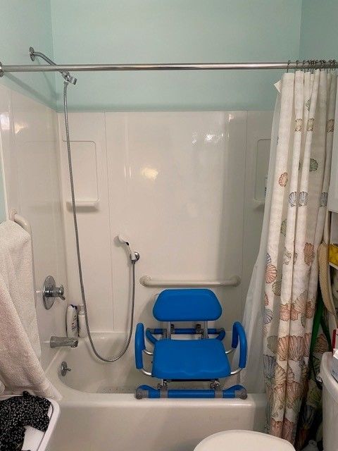
How To Prevent Falls
Remove clutter and make clear walkways in your home.
Be careful and know your limitations when navigating steps. Install appropriate equipment, dual handrails, stair glide or ramp, if no longer able to climb interior/exterior steps.
Use appropriate assistive devices in the bathroom like shower chair, grab bars, toilet safety rails, etc.
Work with an Occupational and/or Physical Therapist if you are experiencing mobility and functional challenges.
Exercise and Stay Active.
Notes:
Unfortunately, our homes can be one of the most dangerous places for falls so it’s important to remove clutter and keep walkways and living areas clear. Remove items like papers, cords, cleaning supplies from floors as well as scatter rugs. Apply rug tape or a non-slip rug pad to all runners and area rugs.
It’s important to know your limitations when navigating steps a fall while on the steps can end in a life changing injury or death. Installing a stairlift or ramp may be necessary to age in place.
As most of us can guess…the bathrooms is the number one place falls occur due to their wet and slippery surfaces. Use appropriate assistive devices like a non-slip rug, shower seat, or toilet safety rails. Grab bars offer support for transferring. Like in/out of a shower or tub and transferring on/off the toilet. Transferring in/out of a tub requires you to balance on one leg so adding a grab bar at the entrance provides something to hold onto for balance. The installation of grab bars are personalized to the user and their height. Typically a grab bar installed vertically at the entrance to a tub/shower, will be installed with the middle of the grab bar at the person’s heart height and a horizontal grab bar on the inside of shower or tub at the person’s wrist height. Install a handheld shower head and holder –this allows you to control where the water goes, especially important if you are using a shower seat or tub transfer bench.
Home modifications don’t have to be expensive it may be as easy as adding a handrail, lowering the height of the bed or reorganizing cabinets to have everyday items within reach.
And if you do notice a change in your mobility, endurance or functioning talk to your doctor about working with a physical and or occupational therapist. PTs and OTs can come to the home and provide outpatient services. This allows the therapist to see how you are functioning in your environment.
Lastly, One of the most important activities we can do to decrease our falls risk is to stay active and exercise. This can be it’s own activity like going to the gym, walking/jogging, playing a sport or it can be from everyday activities like gardening, cleaning, or caring for a pet. What’s important is that you keep moving.

Slide 5
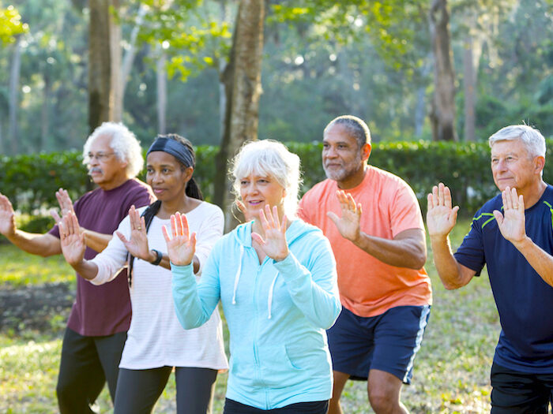
How Can Exercise Help?
Regular physical activity is one of the most important things we can do for our health
Exercise can prevent many of the health problems that come with age, & it helps your muscles grow stronger
Many chronic diseases are linked with inactivity, but research indicates exercise improves heart function & oxygen levels to the brain are increased, which has the potential to decrease cognitive problems

Slide 6
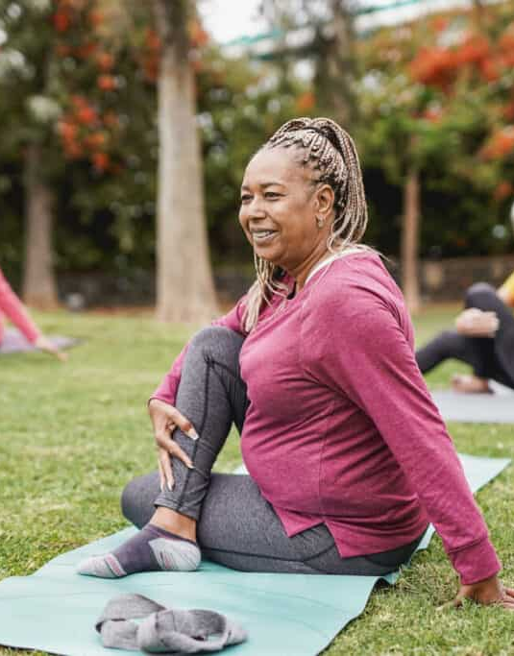
What Can I Do?
Aim for 30 minutes of exercise every day at least 5 days each week
Can be anything that moves your muscles & increases the amount of energy that you use
For balance, try exercises in a standing position or tai chi
For strength, try wall push-ups, stair climbing or exercises with weights or bands
For endurance, try walking, dancing, gardening, bicycling, cross-country skiing or swimming
For flexibility, try stretching, yoga or tai chi

Slide 7
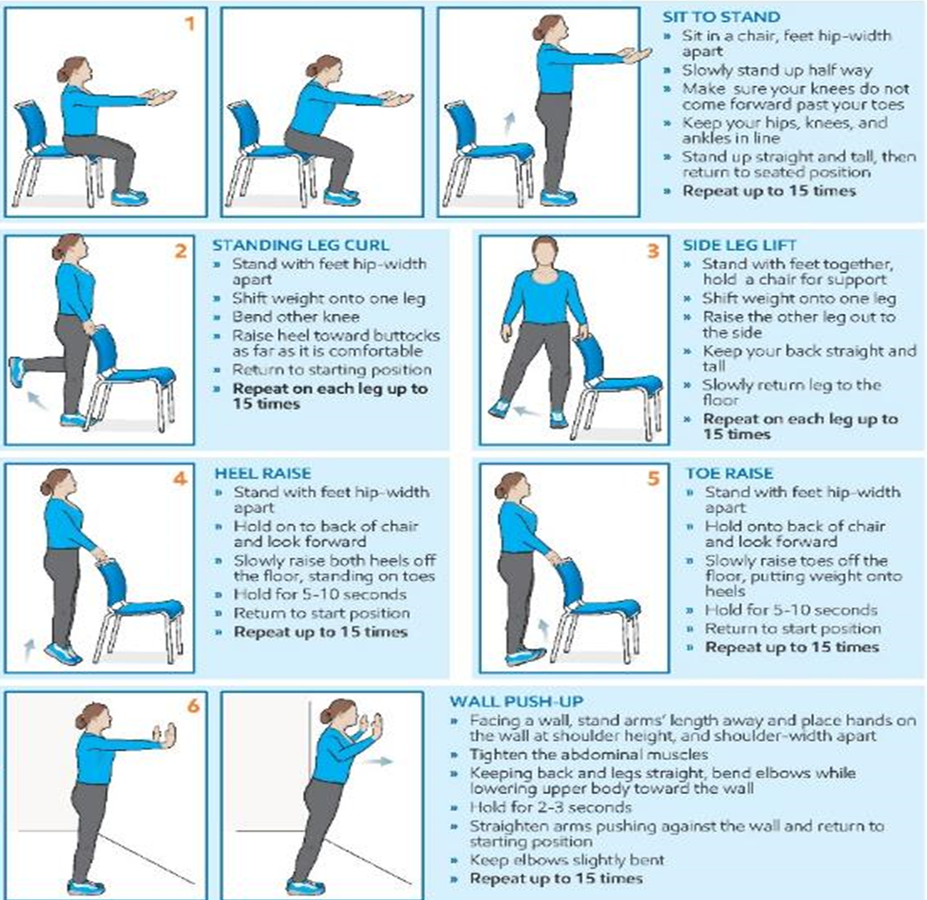
Balance Exercises

Slide 8
More Balance Exercises
Standing Exercises
Seated Exercises
Standing Marches
Leg Lifts/Raises
Weight Shifting
Side, Forward, & Back Step
Squats*
Arm Rotation
Trunk Rotation
Forward Trunk Bending
Sit-to-stands

Slide 9
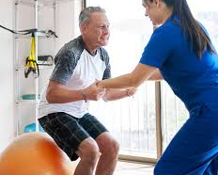
Be Safe While Exercising
Talk to a healthcare professional before beginning a new activity or exercise program to be sure it’s right for you
If you are just getting started, build up slowly and add a few minutes each day, & include activities that strengthen both arm & leg muscles.
No matter what age, our bodies will always get stronger if we are active

Slide 10
What If I Have Fallen?
If you are injured and cannot get up, call for help – consider an alert system or carry a phone with you
Falls can result in serious injury, so after a fall you may feel dizzy, drowsy, or have new aches and pains – see a health care provider right away!
Always tell your healthcare provider if you have had a fall, so you can explore the reasons why you may have fallen & learn how to prevent if from happening again
Please do not lift a person after they have fallen; for you may hurt yourself or hurt the person who fell
Notes:
If you are injured and can’t get up call for help – best practice to always carry a cell phone or have a personal emergency response device. An “I’ve fallen and can’t get up button”, which is especially important if you live alone. Many of these devices now have fall detection on them so if you are knocked unconscious it will contact 911. As well, smart devices like apple watch and android watches have fall detection features.
Falls can result in serious injuries so after a fall, even if you are able to get up, if you feel dizzy, drowsy, or have new pain – contact your health care provider immediately or go to the ER.
If you’ve had recent falls, it’s best to speak with your healthcare provider to explore the reasons why you are having falls so you can learn how to prevent them in the future.

Slide 11
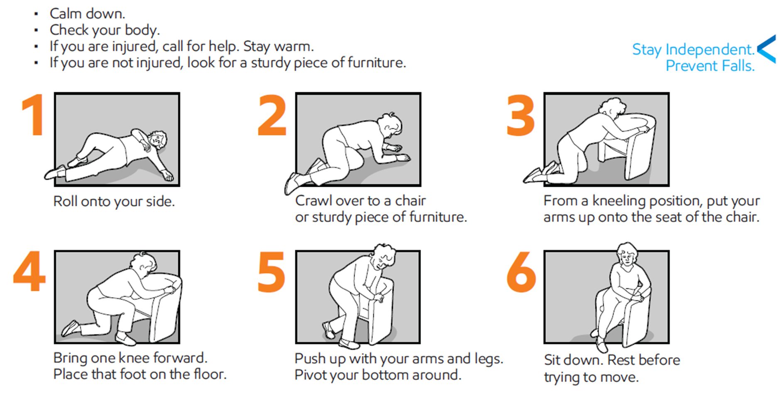
What If I Have Fallen?
Notes:
So what do I do if I fall?
Take a second to breathe and check your self for injury. Did you loose consciousness or if you’re injured? Immediately call for help. Hopefully you have a life alert button or cell phone on you at all times.
If uninjured, get to a crawl position and crawl to a sturdy chair or piece of furniture.
From a kneeling position, put your arms onto the seat of the chair.
Bring one knee forward and place that foot on floor
Push up with arms and legs and pivot your bottom onto the chair.
Sit and take a minute to rest and check again for injury.
If you are with someone who fell. Ask if they are okay – Call for help if injured or lost consciousness. Assist by bringing a sturdy chair to help the person get up if they are able otherwise contact 911 to paramedics assist the person.

Slide 12
Different Center Classes Available
Seated Strength and Balance: This class if for those who prefer a seated workout with the option for standing/balancing exercises. Class will use dumbbells to improve strength and overall mobility as we move to fun music.
Available at the Bain Center on Mondays and Wednesdays at 11:00 AM. Please contact 410.313.7213 for more information and to register.
Better Balance: This class is great fit for someone looking to improve their balance and mobility. This class has been proven effective for people with a chronic condition affecting balance or for those who feel unsteady on their feet. Class includes a couple walking portions with barre and seated exercises. A pre-screening is required before enrolling. To be pre-screened, please contact Rachel Filar at 410.313.6073. This program is partially funded under Title III-D of the Older American's Act of 1965. Individuals 60+ are encouraged to make the suggested donation to ensure viability of the program, and those 59 and under pay the actual cost.
Available at the Ellicott City Center on Mondays and Wednesdays at 2:15 PM. For more information or to register, please contact 410.313.1400.
Available at the Bain Center on Mondays and Wednesdays at 1:00 PM. For more information or to register, please contact 410.313.7213
Balance Through Functional Fitness: This workout will help you be better prepared for real-life situations. Train specific muscles to help you do everyday activities safely and efficiently. Focus on stretching, balance and muscle tone with light weights. This class is designed for those who may feel unsteady on their feet, are post hip or knee surgery with doctors' approval.
Available at the Ellicott City Center on Tuesdays and Thursdays at 10:00 AM. For more information or to register, please contact 410.313.1400.

Slide 13
Different Center Classes Available
Balance-4-All: This class combines a perfect blend of balance, flexibility, posture, strength, and agility. With the use of light dumbbells and a chair, you will work your way to being better equipped to perform routine activities of daily living (ADL) and decrease your risk of falling
Available at the Bain Center on Fridays 11:00 AM. For more information or to register, please contact 410.313.7213
Available at the Ellicott City Center on Mondays and Wednesdays at 10:00 AM. For more information or to register, please contact 410.313.1400.
Core Fit - Strength and Balance: This energizing class combines a dynamic cardio warm-up with total body resistance exercises to build strength, stability, and muscular endurance. The class finishes with all-encompassing core and balance work to challenge and improve your dynamic balance and help you attain your optimal fitness level.
Available at the Elkridge Center on Thursdays at 2:00 PM. For more information or to register, please contact 410.313.5192
Available at the North Laurel Center on Mondays at 12:30. For more information or to register, please contact 410.313.0380.
Flex Tone and Balance: This class focuses on Functional fitness for everyday living. Have fun getting fit and strong while improving your range of motion and balance. Tone your major muscle groups, with this standing exercise program. Class concludes with stretching to increase flexibility and relaxation/visualization. Instructor will show modifications for chair supported option.
Available at the Glenwood Center on Mondays and Wednesdays at 12:05 PM. Please contact 410.313.5440 for any questions.

Slide 14
Thank You! Any Questions?
Rachel Filar, Exercise Specialist
Health and Wellness
(410) 313-6073
rfilar@howardcountymd.gov
Carly Shilling, OTR/L, CAPS
Andrea Bryant, COTA/L, CAPS
Community Living Program
410-313-1234
https://www.howardcountymd.gov/aging-independence/community-living-program

